Slide 1
Cartographic Design

Slide 2
Objectives of map design
Map design
Good map design to communicate information and data clearly, accurately and economically to users having a minimum of map reading skills.
Factors which affect the design process
the map user's requirements,
his/her ability and knowledge of maps,
the complexity of the information to be mapped,
the available methods of map reproduction and costs.
An understanding of the natural or cultural environment being mapped is also necessary to present a balanced reproduction of that region of the world.

Slide 3
Design principles/Objectives of map design
Graphical signs are used in map. The sensation caused by graphical symbols/signs must have to matched to data characteristics and communication objectives in order to satisfactorily portray the information requested. e.g. :
different size of circles in increasing radius will be perceived as increment in quantity or number. Increment size of circles could be used denote number of inhabitants in each ward of a particular VDC.
Different types/symbol of dashes could be used to distinguish various kinds of linear features, roads, transmission line, administrative boundary, hydrography.
Different color(hue)/texture/should be used for different land use types such as residential, commercial, forest, riverine and lake area, agricultural etc.

Slide 4
*
While designing topographic maps, cartographer is governed by conventions such as
Blue for water bodies
Dark green for forest
Red/Pink/Grey for built up area
Yellow for agricultural area
Brown for contour
North at the top of the map body
But while designing thematic maps cartographer focus on information transfer by using the innate characteristics of the variation in graphic characteristics(eg shape, size, color, texture) of symbol used.
Population density on different administrative unit
Volume of traffic along the route of a network
Elevation range
Soil types
Land use types

Slide 5
*
Maintain visual hierarchy. Legibility considerations play vital role.
Information hierarchy should be maintained i.e. the sequence from most to least important aspect of the data to be shown.
The theme/purpose should stand out most, should be given high visual weight. Other map features than the theme is given less weight.

Slide 6
*Map design objectives
Map reader psychology should be understood.
Map reader pre-knowledge about map reading skills should be understood.
Map use environment taken into considerations.
Psychological aspects
Physiological aspects
Subjective aspects
Conventional aspects

Slide 7
*Map design objectives
It is important that the correct impression is gained and that it is gained with a minimum of exertion.
To employ this essence, concept of visual isolation is maintained on the map.

Slide 8
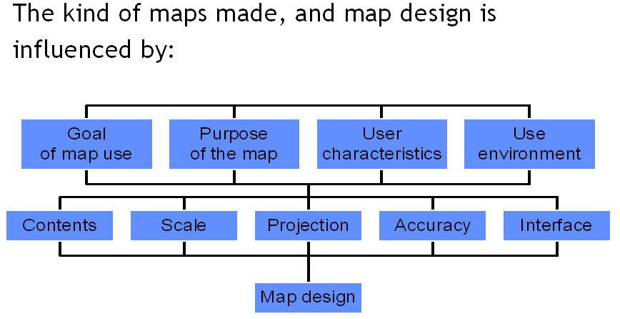
Factors influencing map design

Slide 9
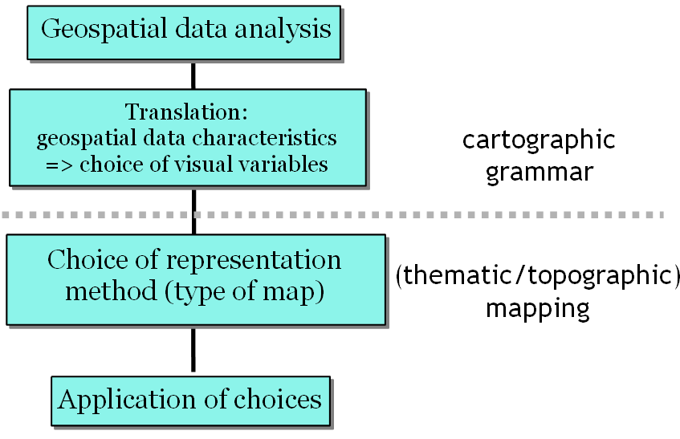
Steps in cartographic/map design

Slide 10
Geospatial data analysis
Can the data be classified / grouped?
Useful for symbol design
Useful for layout of the legend
What are the dimensions of the features?
Point, line, area, volume
Choice of corresponding symbols
What are the measurement level?
Nominal, ordinal, interval, ratio

Slide 11
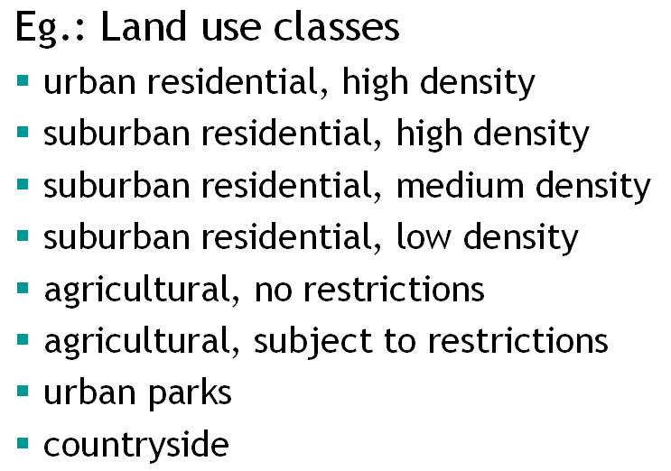
Data classification

Slide 12
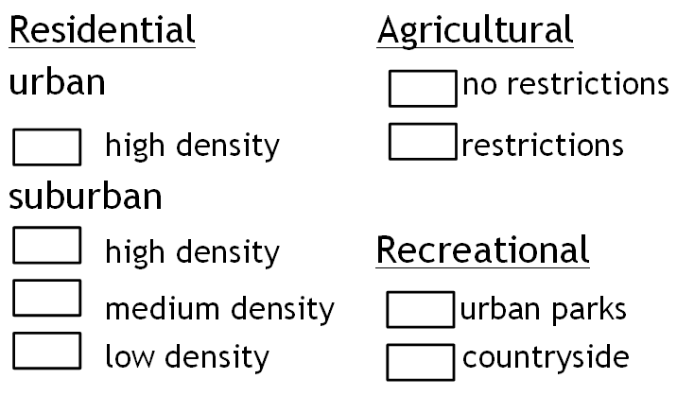
data classification Applied to land use category

Slide 13
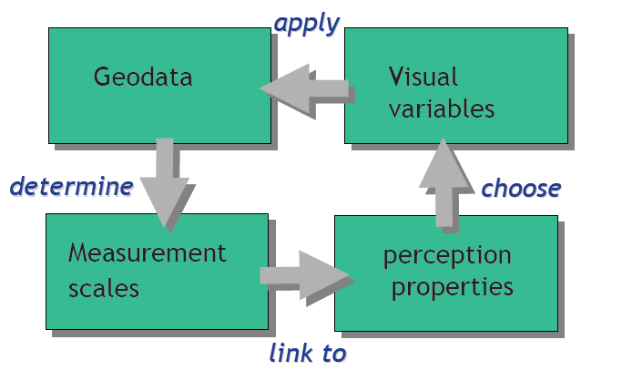
Translation

Slide 14
Perception properties
Associative
All are perceived as being equal
Selective
All are perceived as being different, but forming groups
Ordered
All can spontaneously be placed in an order of magnitude.
Quantitative
All spontaneously create an impression of amount or quantities.

Slide 15
Information type and perception property
Information | Should be represented by a visual variables with the | Perception properties
ratio |  | quantitative
interval |  | ordered
ordinal |  | ordered
Nominal |  | Associative ( +/- selective)

Slide 16
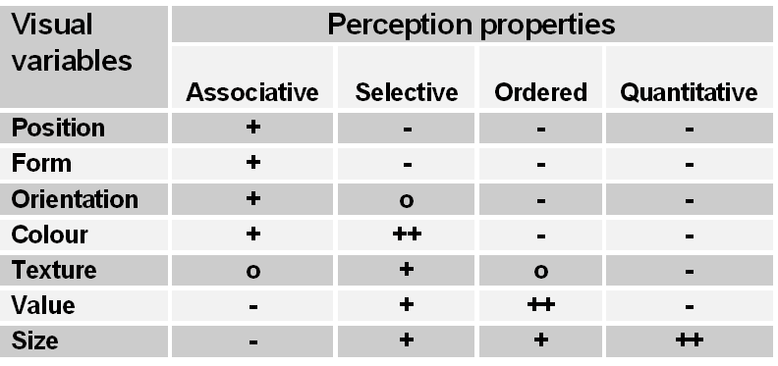
Visual variables and their perception properties

Slide 17
Quantitative data
Absolute quantitative data
Observed, measured or counted numbers
Relative quantitative data
Calculated, derived numbers

Slide 18
Cartographic representation of ratio data
Absolute quantities should be represented by means of visual variable with a quantitative perception
Relative quantities should be represented by means of visual variable with an ordered perception property.

Slide 19
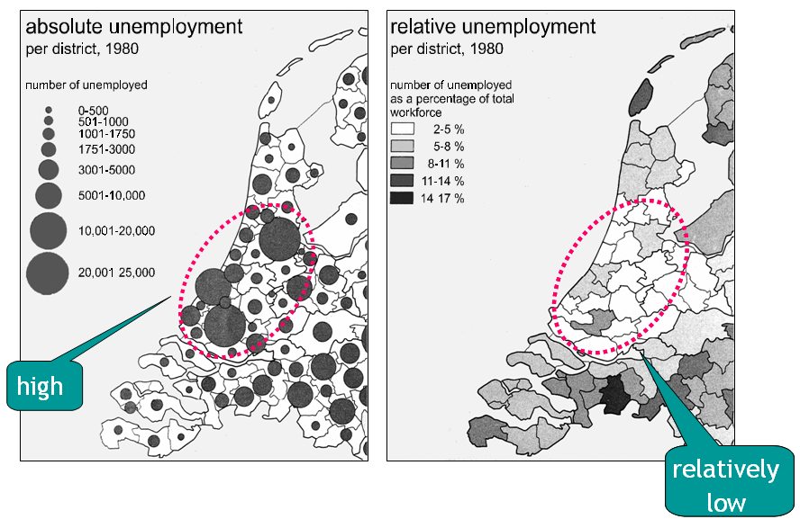
Absolute or relative quantities, see the difference.

Slide 20
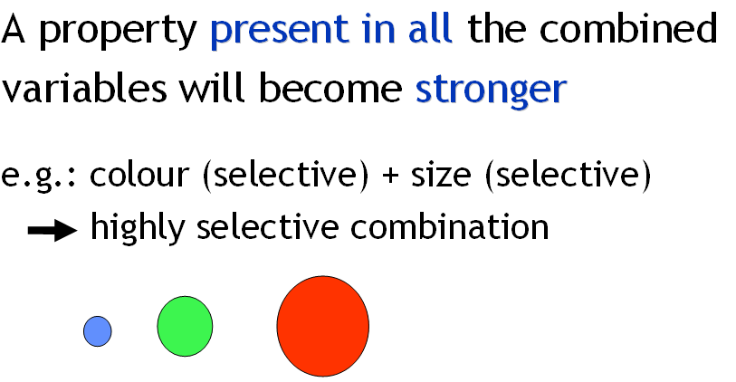
Perception property of combined visual variable

Slide 21
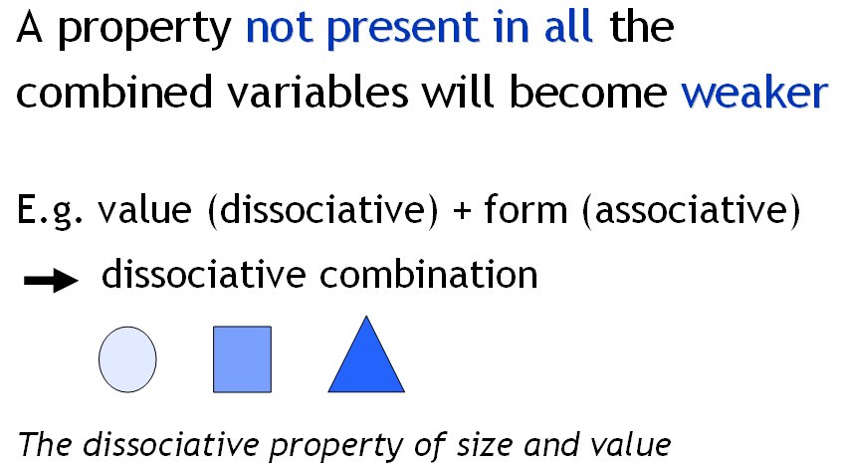
Perception property of combined visual variable

Slide 22
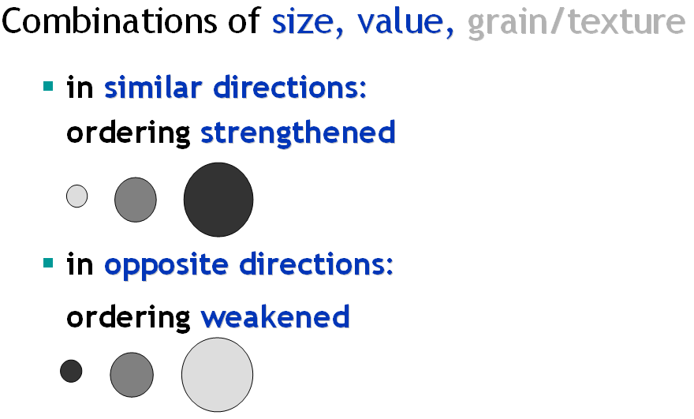
Perception property of combined visual variable

Slide 23
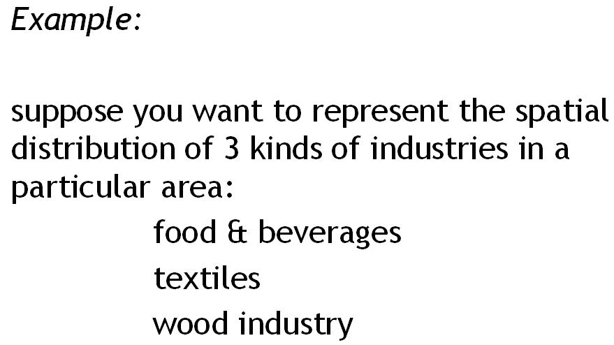
Perception property of combined visual variable

Slide 24
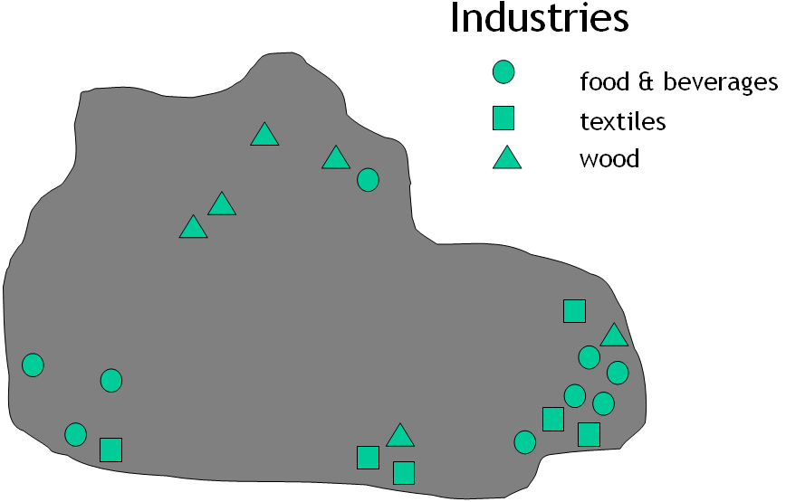
What is the best choice of visual variable?

Slide 25
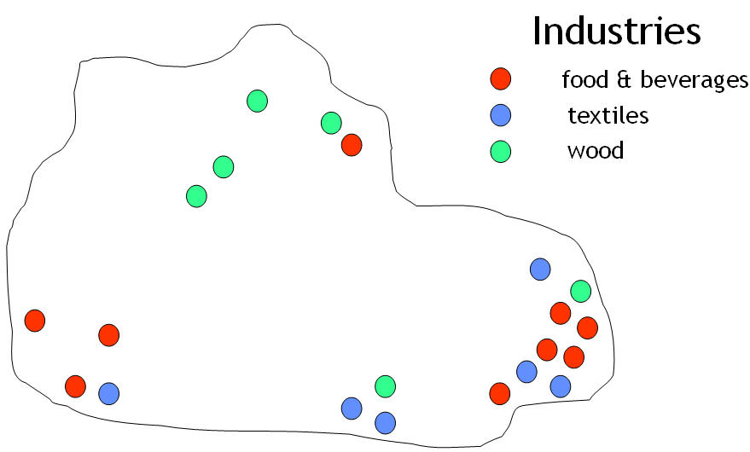
What is the best choice of visual variable?

Slide 26
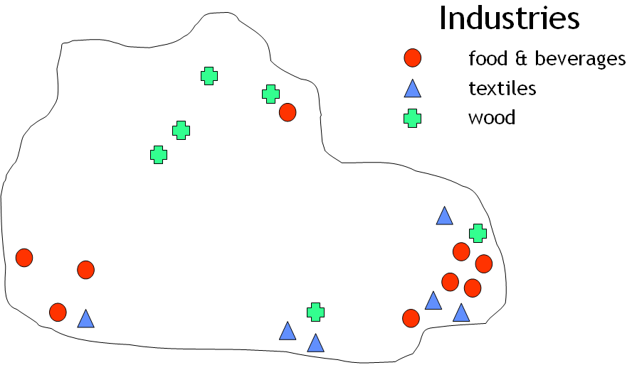
What is the best choice of visual variable?

Slide 27
Principles of Cartographic Design
Design approach
Visual levels ( visual hyrarchy)
Contrast and balance
Symbol categories
Basic identification elements
Emphasis
Basic proportions

Slide 28
Principles of Cartographic Design
Concept before Compilation
make general plan and progress to finer details.
Hierarchy with Harmony
Important things must look important

Slide 29
Principles of Cartographic Design
Visual levels
Applies to the elements within the map and arrangement of all components of map.
Information selected to be the foreground of the product will be the most obvious to the user and must be chosen carefully to fulfill the major objectives of the map.
Supporting information should be treated as background material and given a lower visual level by decreased size, colour intensity, contrast and, therefore, decreased overall importance.

Slide 30
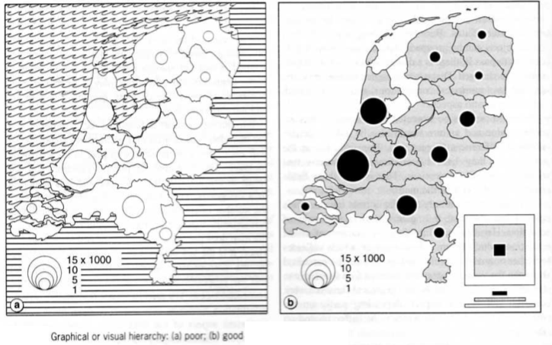
Visual hirarchy

Slide 31
Principles of Cartographic Design
Contrast and balance
As a general rule, the initial design should employ the minimum degree of contrast needed to ensure that all symbols are readable and that dominant symbols appear as such.

Slide 32
Principles of Cartographic Design
Symbol categories
On all maps the subject matter should be organized and displayed in categories of similar items.
Subdivisions of any one category should be shown by symbols representative of their relative importance within the category.

Slide 33
Principles of Cartographic Design
Basic identification elements
Basic identification elements should be clearly differentiated by the use of colour, tone or pattern over either surface.

Slide 34
Principles of Cartographic Design
Emphasis
Emphasis should be given to most interesting or most crucial features which are often relatively small in comparison to the total map area.

Slide 35
Principles of Cartographic Design
Basic proportions
The surface area used for the map face (the area within the neat lines) should be visually dominant.
A good rule of thumb is to keep the map area to about 2/3 of the total area, with the remaining 1/3 for notes, surround, etc.

Slide 36
In conclusion……
Design principles should be such that in produced map there must be
Simplicity
Clarity
Visual hirarchy

Slide 37
Map Design Guides
Map titles and sub-titles
should appear in the largest and/or boldest type
should also be short in length and describe the area or subject portrayed. “Map of” and “Chart of” should be avoided.
Sub-title ( if any ) should be smaller in lettering size and weight than the main title.

Slide 38
Key plan or location map
The primary map area must be outlined and labelled for ease of recognition within the location map to locate the map area geographically in relation to a larger context.

Slide 39
Bar scales
The subdivision should be smaller, exact, convenient units which are appropriate for the scale and map use.
Scales should be neither too long nor too bold to avoid dominating the map.

Slide 40
Legend
The symbol should be on the left, and the notes explaining it to the right of the symbol.
must be exactly as shown on the graphic, i.e. must be identical in size, shape and colour.
Legends must be organized or ranked.
Symbols which do not appear on a product should not be listed in the legend. For series mapping, however, cross-referencing, economics and speed of production may dictate otherwise;
Type (lettering) used for explanations must be simple and small. The lettering size should be the smallest which can be read by people of less than average eyesight, under realistic usage conditions;
wherever possible items should be identified or labelled on the map face rather than including them in the legend, which is a relatively inefficient communication device.

Slide 41
Name placement
4 basic rules of name placement
There should be no doubt as to which place a name refers
Name should be aligned properly and arranged tidily.
Name should appear in the biggest empty area next to the feature being mapped
Name should never cause the obliteration of important or significant detail on the map

Slide 42
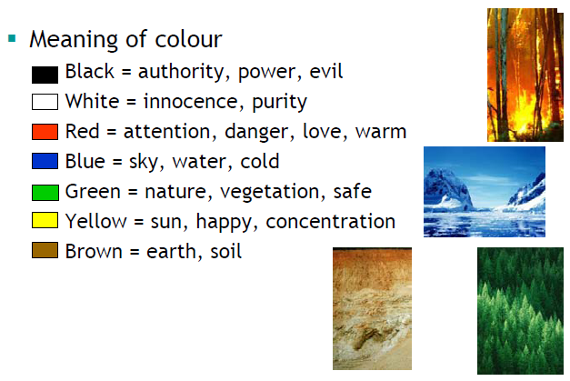
Colour design
Psychology

Slide 43
Balance
If map’s message is balance
then no one colour should overbalance the picture
unless you really want a colour to ‘stick out’

Slide 44
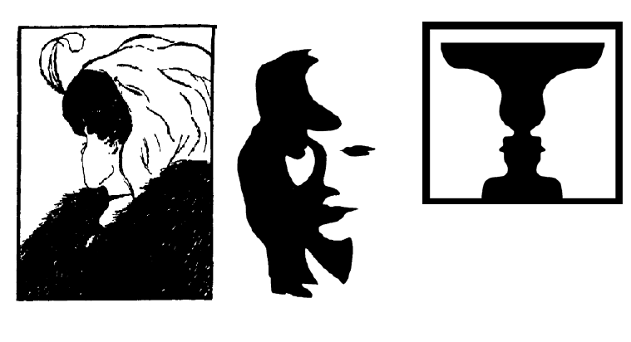
Figure ground

Slide 45
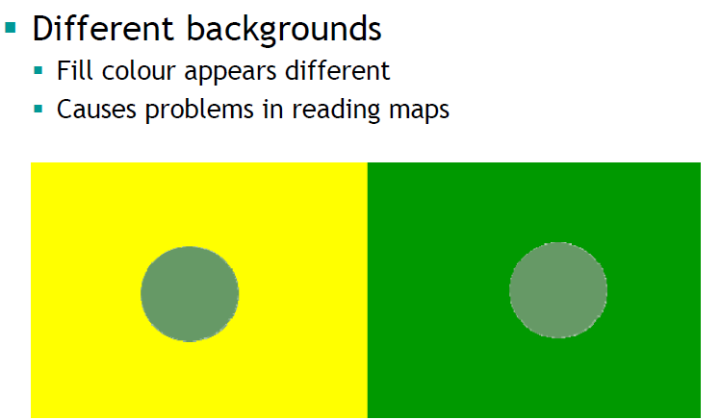
Background

Slide 46
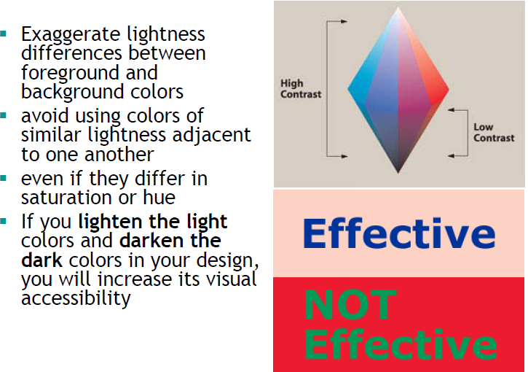
Contrast

Slide 47
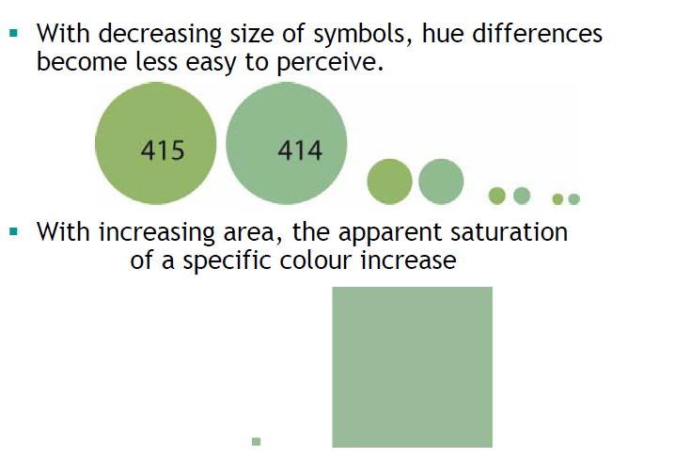
Size

Slide 48
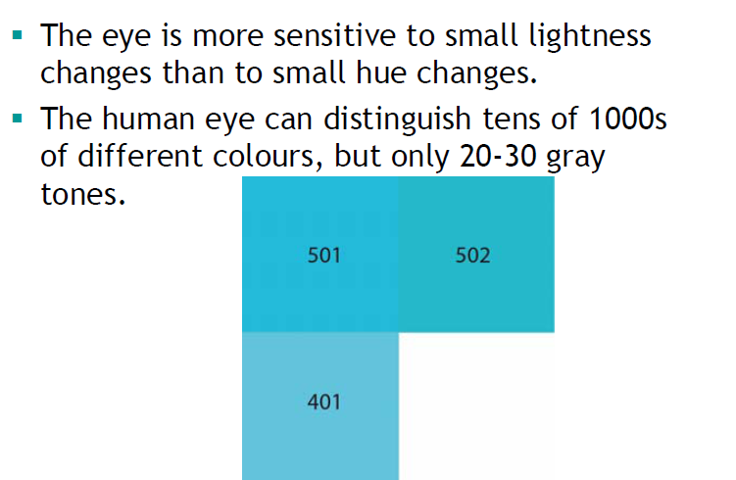
Hue and lightness

Slide 49
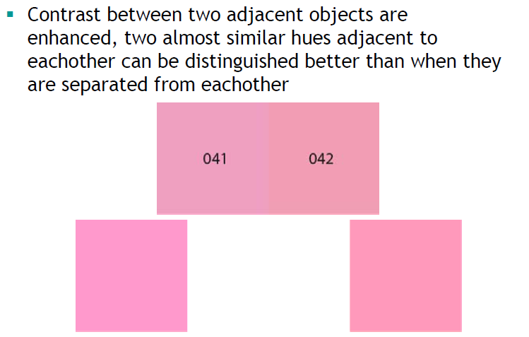
More contrast

Slide 50
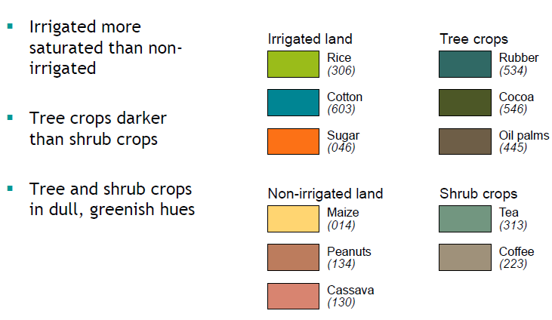
Systematic use of colour

Slide 51
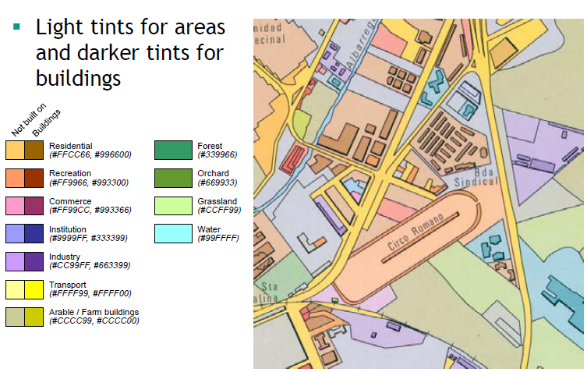
More system

Slide 52
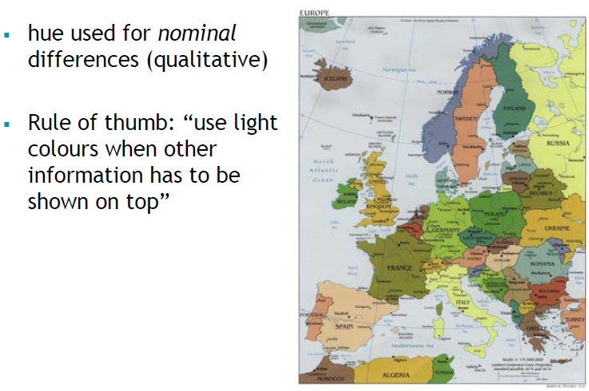
Hue

Slide 53
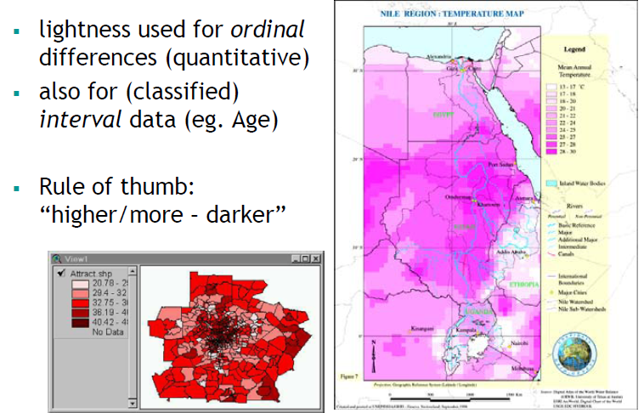
Lightness

Slide 54
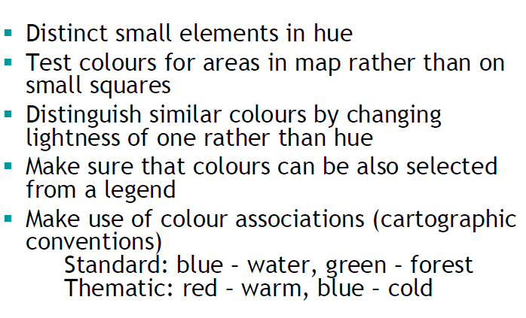
Recommendations

Slide 55
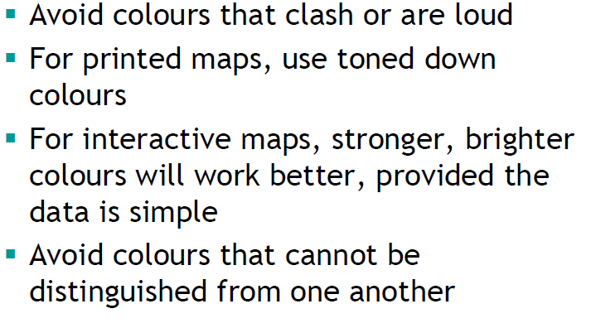
More………

Slide 56
Good map design
Transmits spatially related information in an optimal manner
Restricts itself to the essential substance of the available information
Removes from the map image any unnecessary and insignificant items
Guarantees desired positional precision
Applies a symbolization, which allows for spontaneous and correct association
Is clear in its statement
Obeys the agreed cartographic protocols
Is easily legible
Is aesthetically satisfying
Is efficiently producible

Slide 57
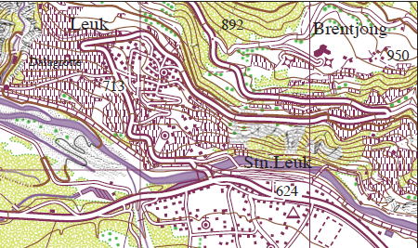
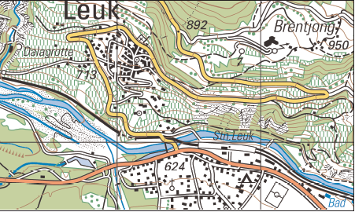
Good and bad map design
☺☺☹
☺
☹

Slide 58
Map accuracy
Accuracy refers to the amount of distortion (or lack thereof) in the representation of features.
Six elements of map accuracy
positional accuracy
attribute accuracy
resolution
logical consistency
currency
Completeness
concern the individual
elements of a data set
Concern the dataset as a whole

Slide 59
Positional accuracy
concerns the measurement of feature locations
Horizontal and vertical
Can be evaluated by check points
Knowing about the quality of database will help to decide if it is appropriate for any project.

Slide 60
Attribute Accuracy / thematic accuracy
concerns the measurement of the characteristics of a feature, and can be greatly affected by data classification.
difficult to assess, but some of the same methods used to measure positional accuracy can be used, such as sampling random features.
However, attribute accuracy can be affected by the manner in which features are represented.

Slide 61
Resolution
Resolution (minimum mapping unit) refers to the size of the smallest feature in a data set that can be discerned.
Resolution and positional accuracy are related
the positional accuracy of any object cannot be greater than the resolution of the map.
the resolution of a data set should influence the scale at which those data are displayed.

Slide 62
Logical consistency
Conformity to rules
Logical consistency refers to the relationships between data items, and whether or not the relationships make sense.
One way to test this is to check whether any given feature has contradictory attributes. For example, suppose your database contains information about land cover, slope, and soil type. Areas with a value of “lake” for land cover should have a value of “0%” for slope, not “10%” or “20%.”

Slide 63
Currency ( temporal accuracy)
Up to date
Depend on Start-date/ end-date

Slide 64
Completeness
Coverage, classification, verification

Slide 65
Thank You

